Slide 1
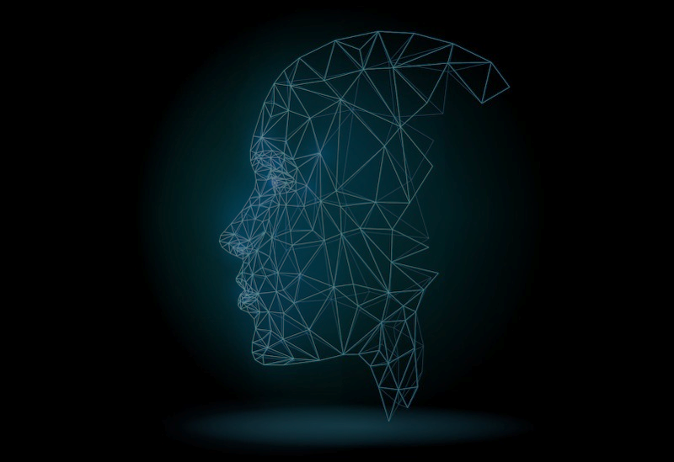
Face Completion Using Generative Adversarial Networks
Purva Raut, Moxa Doshi, Monil Diwan and Karan Doshi

Slide 2

Abstract
Aim: The aim of this paper is to present a novel idea of Face Completion Using Generative Adversarial Networks.
Objective: The objective of this project is to aid the crime investigation department by predicting suspect’s entire face just by a part of their face and textual description. It also automates the work of sketch artist and hence making the process of crime investigation faster and more accurate.
Results: We have achieved 70% accuracy.
Idea: The idea is to in-paint the missing part of the face and address the peculiarities of face using textual description. We intend to achieve the results by applying pixel generation using GAN (Stage 1) combined with text to image conversion using GAN (Stage 2) benchmarking on a custom-made dataset for this task.

Slide 3
Related Work
Image Inpainting using CNN/RNN:
Blind and non-blind inpainting.
32x32 images.
Blur images.
Cannot handle unaligned faces.
Image Inpainting using GAN:
Cannot handle unaligned faces.
128x128 images.
APPROACHES
Text to Image generation:
Stack GAN.
256x256 images.
Overfits.
Data Augmentation:
Gives different images with multiple angles of the same image.

Slide 4
Conclusion of Literature Survey
1
The most appropriate model to be used for face generation will be GAN.
2
To overcome limitations of basic GAN, we propose the use of 2 discriminators i.e. local and global discriminators.
3
Semantic parsing network to further enhance the harmony of the generated contents and existing pixels to increase the resemblance to original image.
4
To avoid overfitting we use Data Augmentation that includes flipping, shifting, rotating and scaling of images.

Slide 5
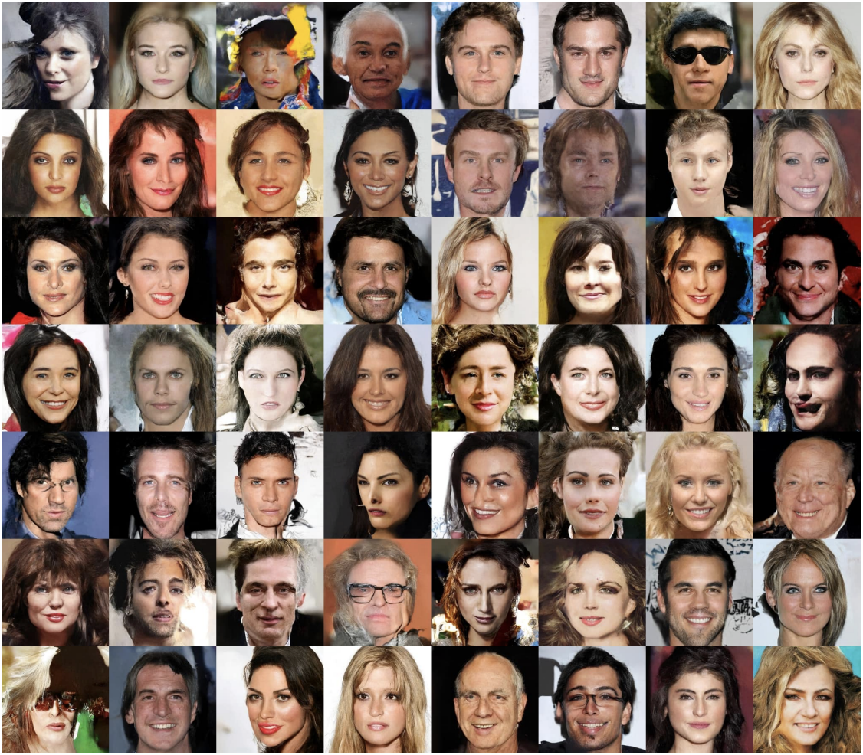

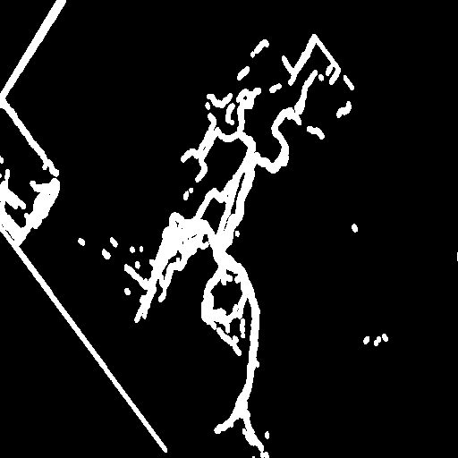
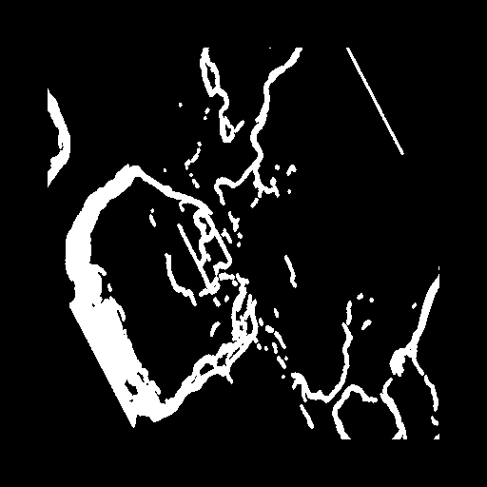
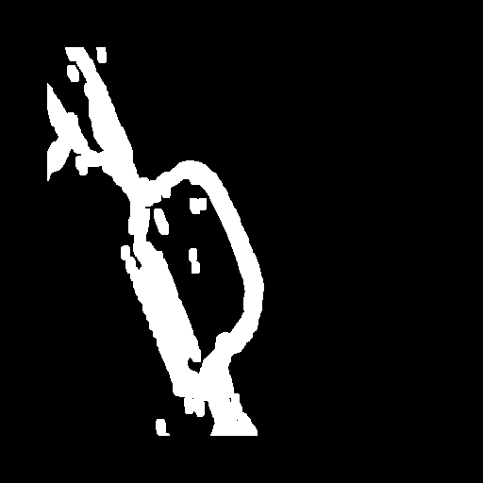
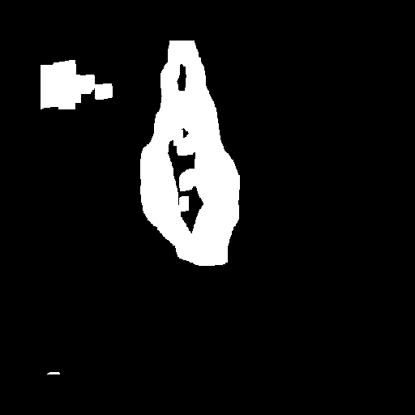
Dataset
CelebA dataset – Center cropped images of celebrities
Two hundred thousand images (200,000).
80% i.e. 162,079 - for training
10% i.e. 20,259 images - for validation
10% i.e. 20,259 images - for testing.
2. Custom made random mask dataset
Twelve thousand random masks (12,000)

Slide 6
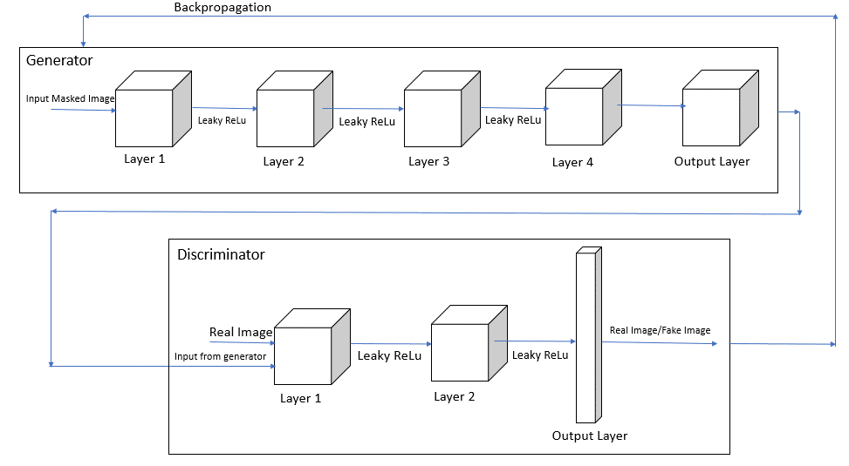
Architecture
Stage - I : Image Inpainting

Slide 7
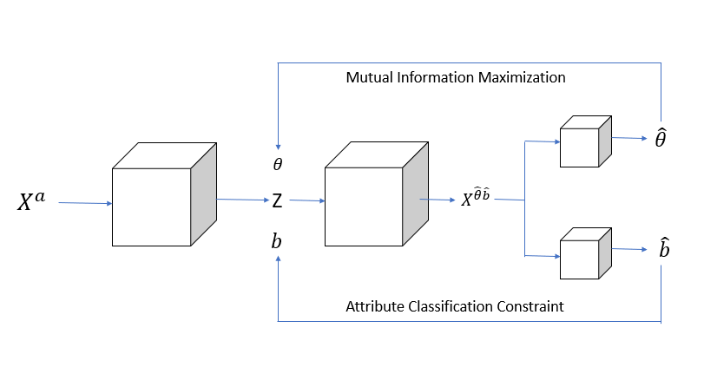
Architecture
Stage II : Text to Facial Features
(Output of Generator from Stage I)

Slide 8
Training
Input:
Images from Celeb A dataset scaled to 28 * 28 dimension.
Masks from our custom mask dataset.
Text describing a peculiar feature of the person.
Pre-processing:
Face Detection using YOLO Algorithm.
Data Augmentation.
Overlaying masks randomly on the face.
Model:
Generator - Generates Image from Image (Stage I) and enhances that image from the provided textual description (Stage II).
Discriminator - Classifies the image from Generator as real or fake.

Slide 9

Training
(Backpropagation)
Loss Function:
Binary Cross Entropy Loss :
$$L=\min_{G}{\max_{D}{E_{x\sim p_{data}(x)}[log{D(x)]+ E_{z\sim p_{z}\left(z\right)}[1−\log\left(1−D\left(G\left(z\right)\right)\right)]}}}$$
Optimizer:
Adam Optimizer

Slide 10
Testing
Input:
An image with partially visible face.
Textual Description.
Face Detection:
YOLO Algorithm.
Model:
Pass the image to the generator only.
Discriminator is not used in testing phase.
Output:
Image with a completed face.

Slide 11
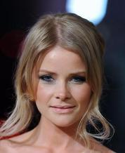
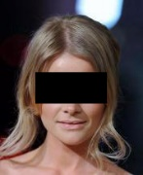
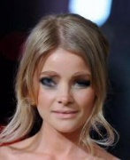

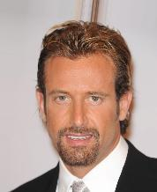
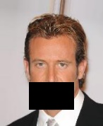
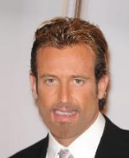


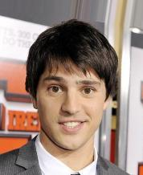
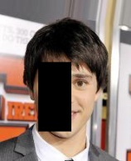



Results
Original Image Masked Image Stage 1 Output Stage 1 Output Stage 2 Output
+ thin eyebrows =
+ french beard =
+ small eyes =

Slide 12
Conclusion & Future Scope
The proposed model can successfully synthesize semantically valid and visually plausible contents for the missing facial parts.
Current accuracy of the model is 70%.
We further try to optimize the model and aim to achieve an accuracy of about 85-90%.
Face can be inpainted in 3 Dimensions.

Slide 13
THANK YOU

